Slide 1



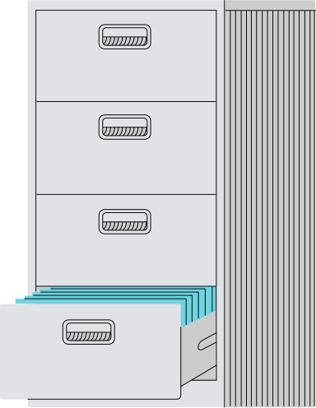


No
Parking
Done By Munzir, Aditya, Vishal
1

Slide 2



What to
Focus?
2
No
Parking

Slide 3
E-Commerce Customer Experience
Churn Rate
AWARENESS
Mostly Acquisition: Capture the attention of potential customers through brand awareness campaigns. Common activities include ads, social media campaigns, SEO, and brand partnerships to reach a broad audience. Cost: High
100
80%
INTEREST
Mostly Acquisition: Engage customers and nurture their initial interest in the brand or product. This stage often involves content marketing, email nurturing, and remarketing efforts to keep customers engaged. Cost: Moderate
20
70%
DESIRE
Between Acquisition and Retention: Persuade customers to seriously consider the product by providing product comparisons, customer reviews, detailed guides, and targeted ads to address specific needs or objections. Cost: Moderate
8
60%
ACTION
Mostly Retention: Convert interested customers into buyers by offering discounts, promotional offers, and ensuring a smooth checkout experience to encourage purchase completion. Cost: Moderate to High
4
20%
LOYALTY
Mostly Retention: Encourage repeat purchases and foster loyalty among existing customers. Strategies include loyalty programs, personalized offers, and post-purchase support, creating a positive ongoing experience. Cost: Low to Moderate
3
20%
ADVOCACY
Mostly Retention: Turn loyal customers into advocates who refer new customers through word-of-mouth. Referral programs, ambassador incentives, and rewards for reviews are effective ways to support advocacy. Cost: Low
2
[*]check the reference of the data
3
No
Parking

Slide 4
Target Group and Segment
Retention
  Cost-Effective: Acquiring a new customer can cost 5 to 25 times more than retaining an existing one. [The BFT]
  Higher Profit Potential: A 5% increase in customer retention can boost profits by 25% to 95%. [Small Business Trends]
  Better Conversion Rates: Existing customers are more likely to make a purchase compared to new prospects. [LoyaltyLion]
Considering Conversation Rate and Cost-Result Ratio, We Choose
DESIRE
ACTION
LOYALTY
  Emotional Connection: Building an emotional connection with customers can increase loyalty by 50%. [Motista]
  Reduce Cart Abandonment: Addressing friction in product discovery and ensuring clear pricing can help lower the cart abandonment rate, which currently affects 69% of online shopping carts. [Baymard Institute]
  Optimize Checkout: Streamlined checkout processes can increase conversion rates, reducing abandonment at the purchase stage and boosting initial conversions by up to 35%.
  Impact on Retention: Customers who have a positive first purchase experience are 3x more likely to return. [McKinsey]
  Repeat Purchases: Loyal customers contribute 40% of revenue despite being only 8% of site visitors. [LoyaltyLion]
  Higher Spend: Loyal customers tend to spend 67% more than new customers. [Adobe Digital Index]
4
No
Parking

Slide 5

Idea Generation
5
No
Parking

Slide 6
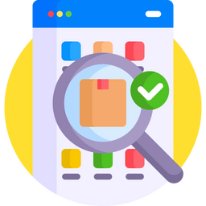





Customer Experience
Customers compare options and save preferred items as they evaluate their purchase choices.
DESIRE
SEARCHING THE “RIGHT” PRODUCT
ACTION
Customers finalize their decision, proceed to checkout, and complete their purchase.
CHECKOUT AND DELIVERY TIME
Customers make repeat purchases and advocate for the brand by recommending it to others
LOYALTY
REFUND, RETURN AND CUSTOMER SUCCESS
6
No
Parking

Slide 7
Customer Controls: Choose your experience
AI-Driven Solution
Moderately Personalized
Deep Personalization
Generalization
DESIRE
Time Spent: 14-21 days
Conversion Rate: 15-20%
Time Spent: 7-10 days
Conversion Rate: 25-30%
Time Spent: 3-5 days
Conversion Rate: 60%
ACTION
Time Spent: 7-14 days
Conversion Rate: 10-20%
Time Spent: 5-7 days
Conversion Rate: 30-40%
Time Spent: 1-3 days
Conversion Rate: 50-70%
LOYALTY
Time Spent: <1 month
Repeat Purchase Rate: 10%
Time Spent: 1-3 months
Repeat Purchase Rate: 30%
Time Spent: 6+ months
Repeat Purchase Rate: 60%
[*]check the reference of the data
7
No
Parking

Slide 8
Control and Governance
Own Your Data
Explainable AI
Differential Privacy
MODERATE PERSONALIZATION
DEEP
PERSONALIZATION
GENERALIZATION
Customers in this category prefer a broad, non-personalized shopping experience.
The system operates using aggregate market trends, popular products, and seasonal insights without storing or utilizing any customer-specific data.
These users opt for a balanced approach, where Federated Learning provides personalized recommendations
The system learns from each user’s behavior directly on their device, ensuring data localization. Only anonymized model updates are shared to refine the general algorithm, with no personal information exchanged.
These users seek the most customized experience, with Deep Personalization leveraging their full scope of consented data.
By giving explicit consent, customers allow data to be stored on secure servers, where it undergoes analysis to provide highly relevant, data-driven product recommendations. This option is governed by strict privacy protocols and transparency regarding data use.
Pros
Cons
Pros
Cons
Pros
Cons
  Maximum Privacy
  Diverse Product
  More Shopping Time
  Less Relevant Suggestion
  Balance Privacy and Customisation
  Personalised experience
  Device performance might be affected
  Customised Recommendations
  Less Shopping Time
  Privacy Concerns
  Explicit Consent
Better Shopping Experiece
Control Over Your Data
8

Slide 9

Control and Governance
Own Your Data
Explainable AI
Differential Privacy
?
Your Data
Recommendation
Black Box
White Box
Others
Our Product
Because You Deserve to See How Your Data Drives Decisions For You
9
No
Parking

Slide 10


Control and Governance
Own Your Data
Explainable AI
Differential Privacy
Training AI Models with Adding Noise, Protecting Data
Analyzing Data with Integrity: Safeguarding Privacy Every Step
Ensuring Ethical AI: Independent Audits and Annual Reports for Full Transparency
Your Information
Noised Information
10
No
Parking

Slide 11
Use Cases
  Find the “Right” Product: Leverage AI to help customers identify products that best match their needs by analyzing preferences, browsing history, and popular trends, thereby enhancing shopping satisfaction.
  Agentic RAG for Enhanced Responses: Use Agentic Retrieval-Augmented Generation (RAG) to reduce data hallucinations in chat responses, ensuring customers receive accurate and relevant information. This approach also supports AI governance by improving model reliability and trustworthiness.
  Chatbot Features and Interaction: Deploy AI-driven chatbots to handle a range of customer queries, from basic product inquiries to more complex issues, offering real-time, automated assistance that enhances user experience and reduces support workload.
  Product Installation Assistance: Provide customers with interactive, step-by-step guidance on product installation through AI-driven chatbots or augmented reality, reducing the need for support calls and improving post-purchase satisfaction.
  Track Current Orders & Automated Delay Notification: Enable customers to track their orders in real-time, with automated notifications for any delays, improving transparency and customer satisfaction by keeping them informed of their order status.
11

Slide 12
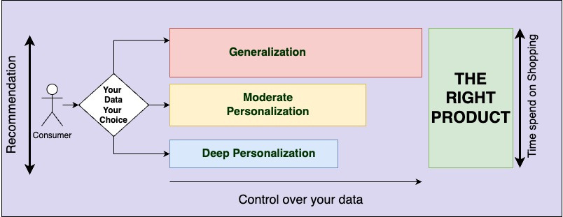
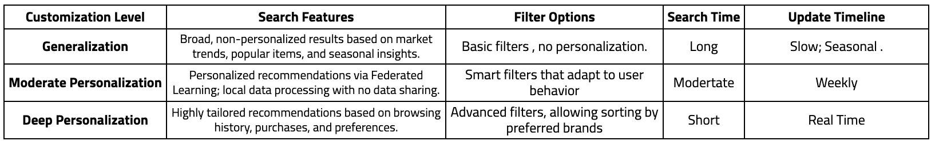
Find the “Right” Product
12
No
Parking

Slide 13
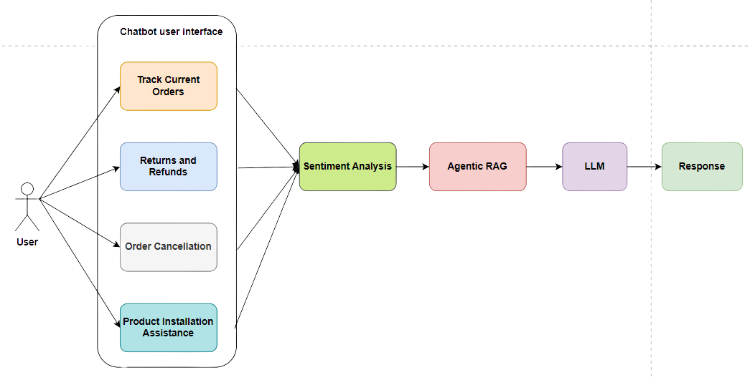
Chatbot features and interaction
Agentic RAG can reduce data hallucinations, enhancing response quality and relevance, and serves as a method for implementing AI governance in AI model development.
13
No
Parking

Slide 14
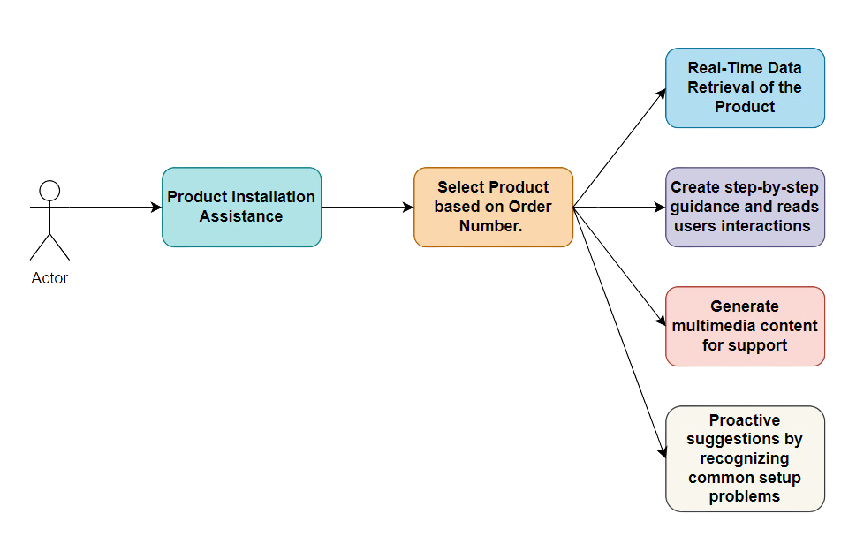
Product Installation Assistance
AI Governance
  Data Retrieval aligned with data protection and compliance policies, making sure only data required for the task is retrieved. Achieved by implementing strict access controls.
  Glassbox models in AI chatbots and systems for increased transparency and trust in decision-making of the AI system
  Automated Feedback Systems to gather user interactions and make the model better informed.
14
No
Parking

Slide 15
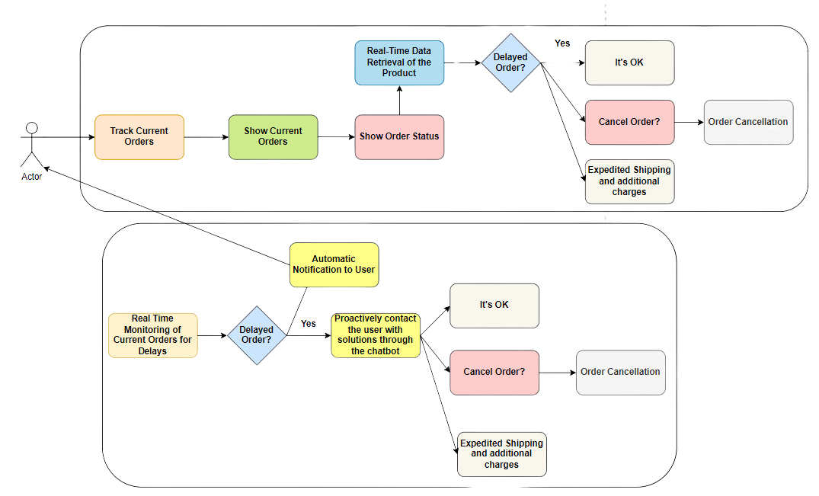
Track Current Orders & Automated Delay Notification
15
No
Parking

Slide 16
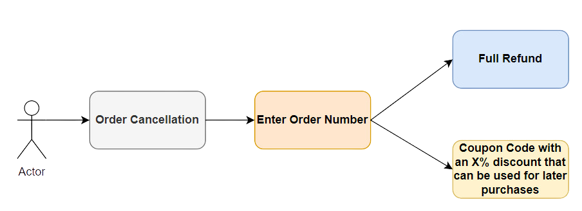
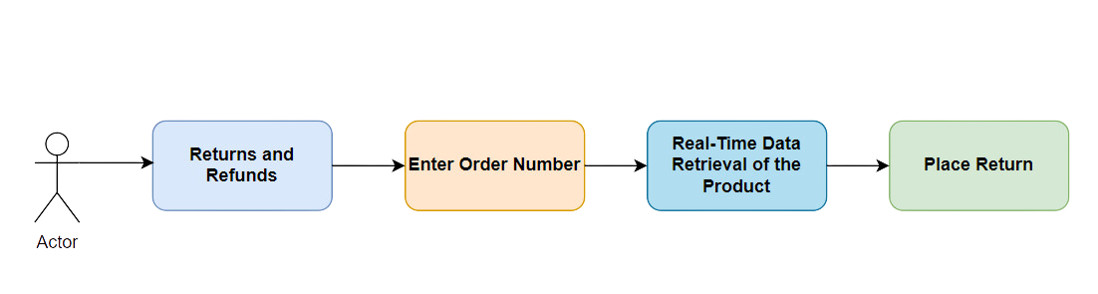
Order Cancellation and Returns and Refunds
16
No
Parking

Slide 17
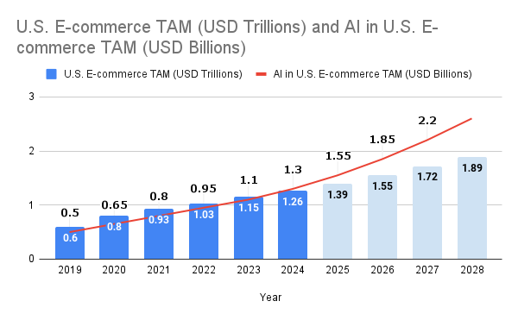
Market Research
  Reduced Operational Costs: AI-driven chatbots and automation reduce labor costs by up to 30%. Gartner
  Increased Sales Through Personalization: AI-powered recommendations boost conversion rates by 15-35%, driving higher sales and customer retention. McKinsey
  Optimized Inventory Management: AI-based demand forecasting reduces overstock costs by 20-50% and minimizes stockouts, ensuring efficient inventory. Boston Consulting Group
17
No
Parking

Slide 18
Value Proposition
Target Customer:
  Current customers on the ecommerce platform
Pain Points:
  Lack of personalized customer support leading to reduced loyalty of customers on the platform
  Lack of efficient product installation support leading to negative experiences
  Lack of efficient search personalization at the user’s preference leading to time-consuming browsing experience
  Lack of efficient order tracking and management systems, leading to frustration and dissatisfaction
  Lack of a one-stop tool to address customer queries
Features:
  Integrated AI Chatbot with sentiment analysis to provide personalized customer support
  Efficient AI driven Agentic RAG + LLM models to assist customers in efficient product installation support
  Personalized search experience using AI, AI Governance, and flexibility of control over data
  Real-time order tracking and automatic delay order notification to the customers. Proactive recommendations and support for returns, refunds, and order cancellations.
  Maintenance of AI Governance to retrieve and use only data required for the completion of the task
Market:
1) Global ecommerce market:
$6 trillion market, expected to reach $8 trillion by 2026 with a growth-rate (CAGR) of 10-15%
2) US eCommerce market:
$1.26 trillion market, expected to reach $1.55 trillion by 2026 at a CAGR of 10-12%
2) US eCommerce Chatbot Market:
Approx. $4 billion by 2026
18
No
Parking

Slide 19


Product Roadmap
Quarter | Objective | Key Features | Milestones | Estimated Cost ($) | Expected Return/Savings ($)
Q1 | Establish Core Foundation for Chatbot | Core Chatbot, Basic Order Tracking, Analytics Setup (MVP) | Functional Chatbot, Initial Analytics Operational | 50,000 | 0
Q2 | Develop Advanced Order Management & Sentiment Analysis | Enhanced Order Tracking, Returns & Refunds, Sentiment Analysis (MVP) | Automated Delay Notifications, Sentiment Analysis Enabled | 75,000 | 100,000
Q3 | Enhance Personalization & User Experience Optimization | Personalized Search Toggle, Feedback Collection, A/B Testing | Personalized Search Feature, User Feedback Integration | 60,000 | 120,000
Q4 | Optimize Model, Soft Launch, and Plan Expansion | Model Fine-Tuning, Soft Launch, Roadmap for Future Features | Soft Launch Completed, Real-Time Monitoring in Place | 55,000 | 150,000
Q5 | Add Multilingual Support & Proactive Assistance | Multilingual Support, Proactive Assistance, Product Recommendations | Language Detection, Proactive Suggestions, Cross-Selling Features | 65,000 | 180,000
Q6 | Integrate Advanced Analytics & Continuous Learning | Advanced Analytics Dashboard, Performance Optimization, Continuous Learning | Enhanced Analytics, Real-Time Performance Tracking, Adaptive Learning Model | 70,000 | 200,000
19
No
Parking

Slide 20



Business Plan
Effort Sizing
Q1 (Core Foundation): High Effort
Architecture setup, core chatbot development, and basic analytics setup.
Q2 (Order Management & Sentiment Analysis): Medium-High Effort
Development of order tracking, return/refund workflows, and sentiment analysis integration.
Q3 (Personalized Search & Optimization): Medium Effort
Adding personalized search, user feedback mechanisms, and A/B testing.
Q6 (Advanced Analytics & Continuous Learning): Medium Effort
Focus on advanced analytics, performance optimization, and continuous model learning.
Q4 (Soft Launch & Expansion Planning): Low to Medium Effort
Refinement, soft launch, and analytics-based planning for the next feature expansion.
Q5 (Multilingual & Proactive Assistance): Medium-High Effort
Introduces multilingual support, proactive suggestions, and product recommendation capabilities.
20
No
Parking

Slide 21


Business Plan (Contd)
What value does it bring ?
  24/7 Support: The chatbot provides round-the-clock assistance, addressing customer inquiries and issues at any time, thereby improving satisfaction and loyalty.
  Automated Order Management: The chatbot handles order tracking, returns, refunds, and cancellations, reducing the workload on human staff and minimizing errors.
  Scalability: The chatbot can manage increasing customer interactions without proportional increases in staffing costs.
21
No
Parking

Slide 22

Business Plan (Contd)
Global Strategy
Scalable
Pricing
Ethical AI
Analytics
Tiered Pricing to Fit U.S. Business Segments: Develop pricing plans based on U.S. business needs, with tiered options for small, medium, and large enterprises. Include value-added features (e.g., advanced analytics, sentiment analysis) in premium tiers to justify higher pricing.
Transparent Data Use and AI Ethics: Emphasize transparency in data usage, AI ethics, and privacy to align with U.S. consumer expectations for ethical AI. Highlight these features in marketing to build trust, especially as data privacy concerns grow.
Real-Time Performance Metrics: Offer metrics tailored to U.S. retail cycles and customer preferences, such as customer satisfaction, response times, and query trends, enabling businesses to respond rapidly to market changes.
Resilience and Load Management: Implement load-balancing and failover mechanisms to handle peak times and unexpected surges, maintaining performance across all regions.
22
No
Parking

Slide 23
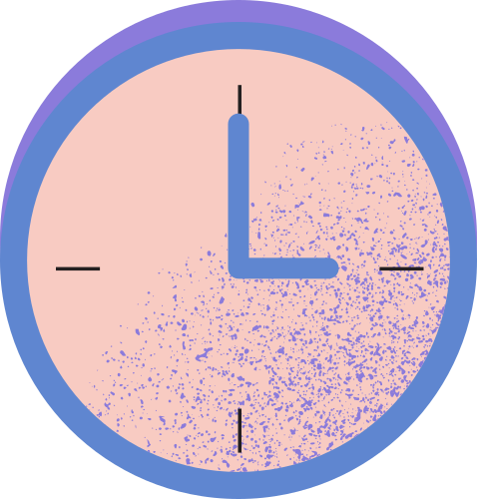



Thank You!
23

